Slide 1
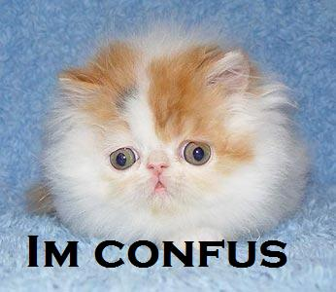
The question to start with…
What the heck is “poetry”?

Slide 2
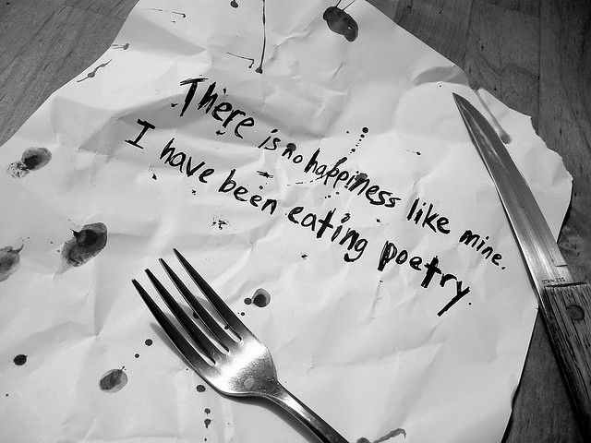
A poem can be baffling to explain…
A lot of poetry, especially modern poetry is non-metrical. It’s not confined to writing that rhymes, for many poems do not use rhyme.
And though most poetry is written in lines, prose poems don’t have line divisions.
Much poetry uses figurative language and is intense and emotionally complex—but the same is true of powerful prose.
Whatever characteristics one tries to apply are neither typical of all poetry nor exclusive to poetry.
So, what can we say that poetry is?

Slide 3
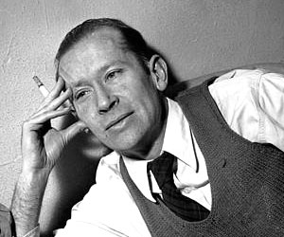
Those who we’d think ought to know…
Poets themselves, usually over subjective responses…
E.E. Cummings said that poetry is “dancing on your own grave.”

Slide 4
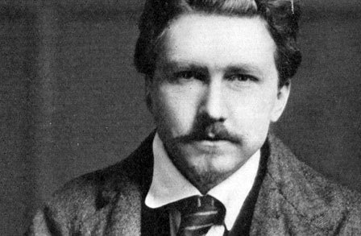
Ezra Pound purportedly stated it is “what poets write.”
Emily Dickinson describes poetry by its effect: “If I read a book [and] it makes my whole body so cold no fire ever can warm me, I know THAT is poetry. If I feel physically as if the top of my head were taken off, I know THAT is poetry. These are the only ways I know it. Is there any other way?”

Slide 5
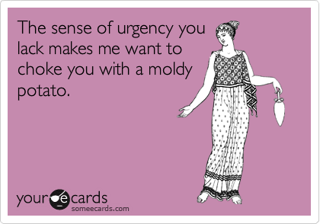
Poetry arises when some deep impulse needs expression, and a poem is the most effective way to express it.
The poem comes from a sense of urgency; it feels it must be “let out,” shared, given, offered up.

Slide 6
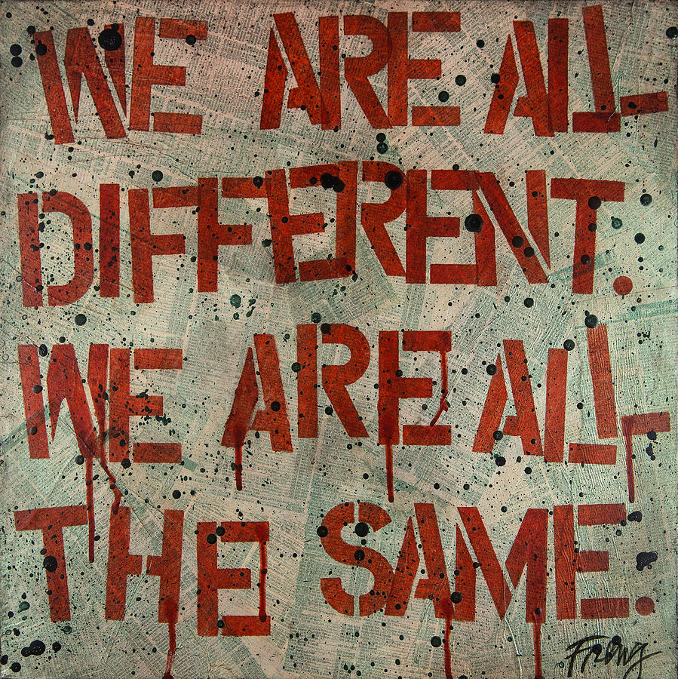
What does poetry do? (Maybe this is a better question to ask ourselves)
Poetry makes connections. We are all citizens in the culture of joy, pain, anger, love, fear, despair, and hope. Every one of us carries the same emotions as everyone else. Our situations, stories, and conflicts may differ; but the news from the heart comes to each of us.

Slide 7
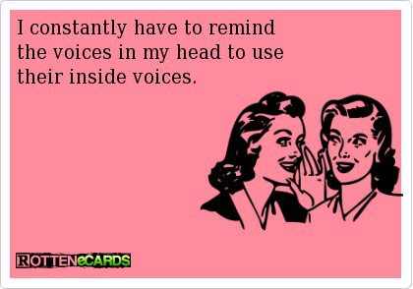
Poetry gives voice. In our day-to-day lives, voices come at us—from the Internet, news media, sales pitches, cell phones, movies—creating information overload. It often seems our own voices are not heard. Poetry offers a chance to speak, and to speak from the deepest part of our selves.

Slide 8
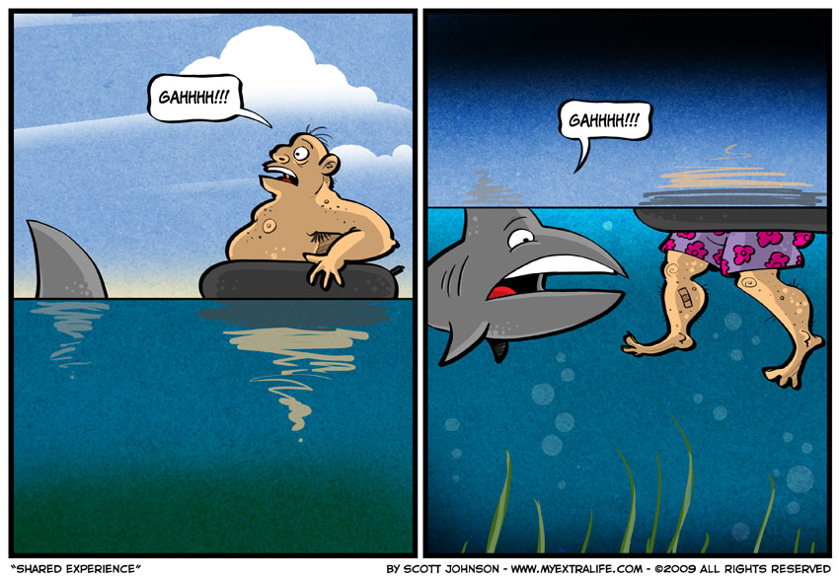
Poetry tells stories. We read poems as we do other stories, to discover what happened and why. We read them to feel part of a larger world, where we encounter experiences we might otherwise never have and where we may discover that our experiences are shared by others.

Slide 9
Poetry describes. Poems may describe a person, a relationship, a city street, a scene in nature, or almost anything else—using vivid, precise language that enables readers to conjure up clear images. Descriptive poetry enables us to see the world more precisely, more vividly. More often than not, a poem, like most great art, will give us new perceptions, fresh ways of seeing what is around us.

Slide 10
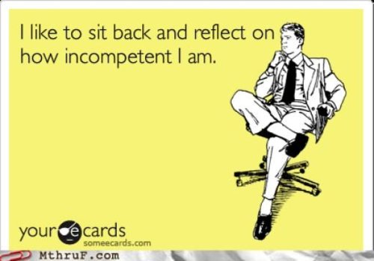
Poetry reflects. Poetry sometimes puts readers right into a poet’s head and heart, allowing us to share the poet’s thoughts and feelings.

Slide 11
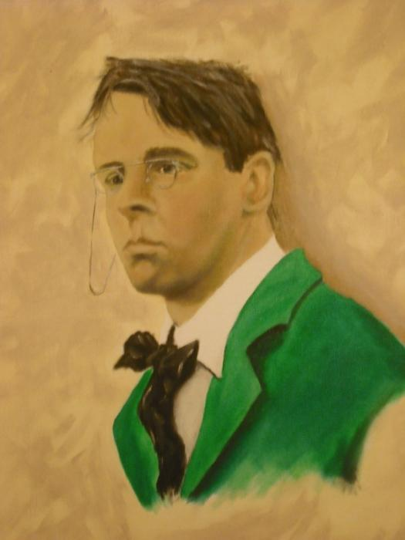
Poetry remembers. Poet William Butler Yeats called memory the wellspring of poetry. In one sense, a poem can come from nowhere else but the past. Poems can be acts of preservations, saying forever what has gone by, what will never happen in quite the same way again.

Slide 12
Poetry expresses, embodies, and kindles emotions. In reading poetry, you may find a companion, someone who also has felt what you have felt. Poems can touch you and connect you to what is best in you, whether it be outrage at injustice, sorrow for another’s loss, or joy for another’s good fortune.

Slide 13
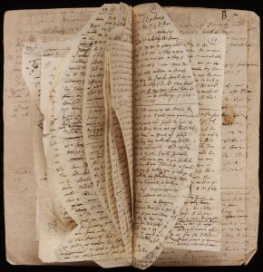
Poetry celebrates language. Poets live in language. Words are as real to them as a cup of coffee. They use language to draw us past the words themselves and into the mystery of experience. Yet poets also draw our attention to language by uncommon uses of words and phrases.

Slide 14
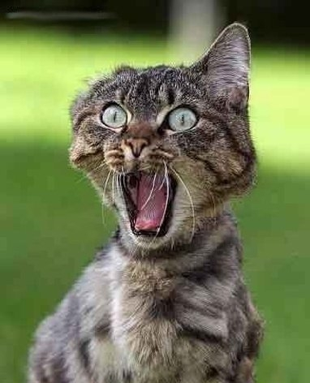
So, how the heck do you even start?
You may have never approached a poem before. Do not fear! Here are some practical tips! ☺

Slide 15
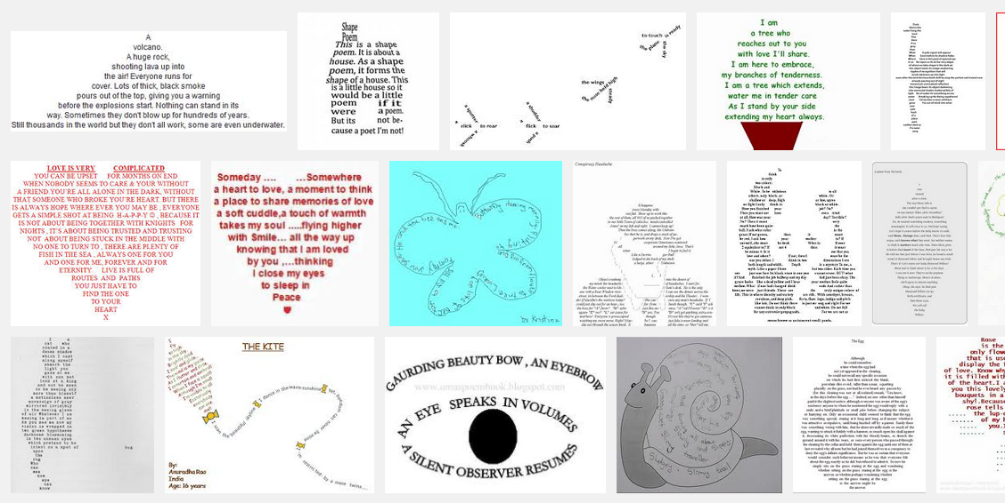
Look at the poem. Start by simply looking—at its shape and the way it appears on the page. Poems can have a visual effect in addition to the effects created by language, sounds, and ideas.

Slide 16
Read straight through. Get a feel for the poem without worrying about what you don’t know or understand. Just wander through, stopping for a bit along the way to wonder about or savor a word or a line.

Slide 17
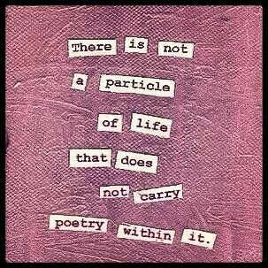
Pay attention to the title. The title is usually not just the “name” of the poem. Rather, it often establishes the context for the poem’s subject. It is often significant and revealing, though its significance may not be evident in the first reading.

Slide 18
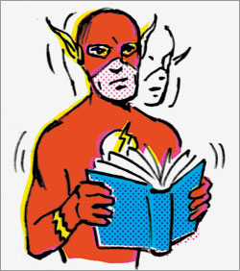
Slow down and reread. So you can really hear the poem. You shouldn’t speed-read a poem any more than you would speed up your favorite song.

Slide 19
Read aloud. Most poems are meant to be heard as read silently. Find a private place if you are worried that someone will laugh at you (but seriously most roommates are crazy anyways).

Slide 20
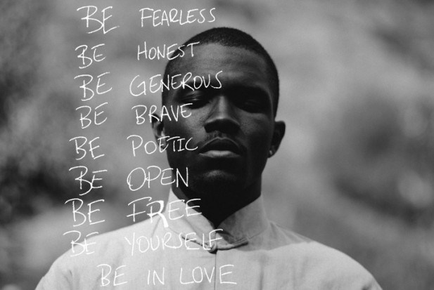
Open yourself to the poem. Poems can lead us to feel intensely, to experience deeply, to perceive freshly, to understand experiences differently from our own, and to affirm our own ideas, feelings, and experiences.

Slide 21
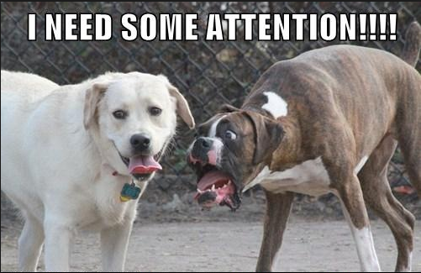
Focus on what catches your attention. Paying passionate attention to what is actually in a poem is a wise starting place.

Slide 22
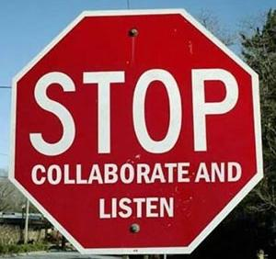
Watch the words. Don’t be overly eager to figure out a poem’s “meaning.” You don’t ask what every tree means in a forest (hopefully). Look at the words, listen for what they say, and understand them as best you can.

Slide 23
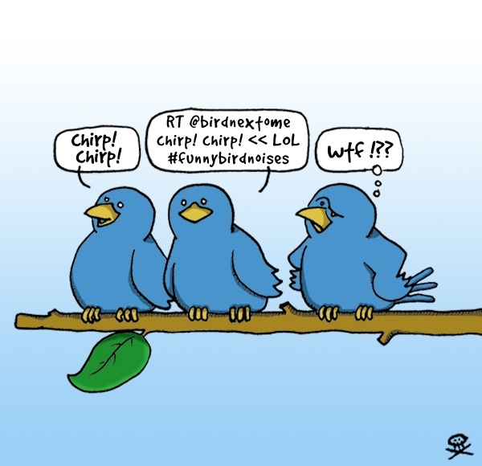
Follow the sentences. The sentences in the poem may be broken up into lines, but they are still sentences. If a poet uses incomplete sentence or “fragments,” try to figure out their purpose.

Slide 24
Ask questions. Try asking questions such as, What is happening in this poem? What is this poem doing? Why am I drawn to that phrase or line? What is the poem connecting me with or challenging me about? How is the poem shifting my usual way of seeing things and leading me to reconsider the ways I’ve thought and felt?

Slide 25
And finally, let the poem be itself. Poetry isn’t a foreign language (I swear) that needs to be translated. If a poem says it’s about stopping by the woods on a snowy evening, trust what it says. Some readers may argue that it’s also about something more, and that may be true. A poem often has a number of implications, but remember that it can’t mean just anything.

Slide 26
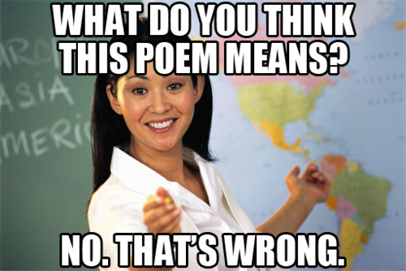
Every single person in this room is capable of writing.

Slide 27
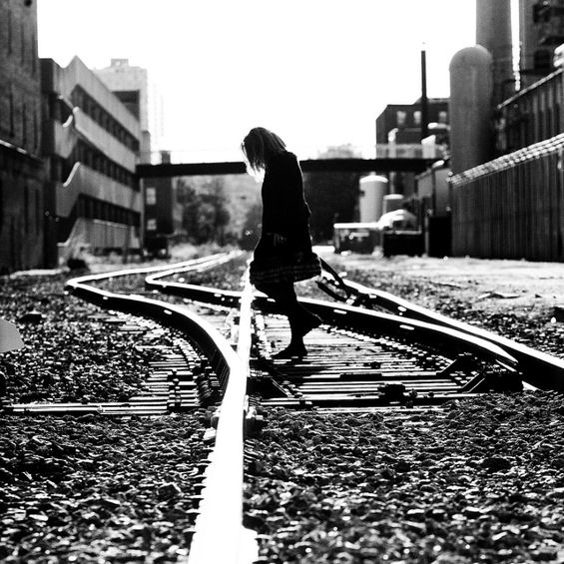
Leaping in the dark
You may have fears: fear of failure, of not writing well enough, of making yourself vulnerable to those who read your words. Many seasoned writers have felt the terror of the blank page, and have spent difficult periods, sometimes lasting for years, during which they simply could not begin the work they longed to do. There is a lot of uncertainty in any creative act…

Slide 28
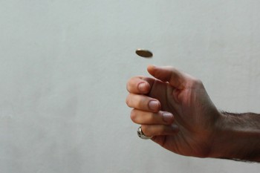
Build up your confidence
It’s useful to recognize that uncertainty is going to be there, however you feel about it.

Slide 29
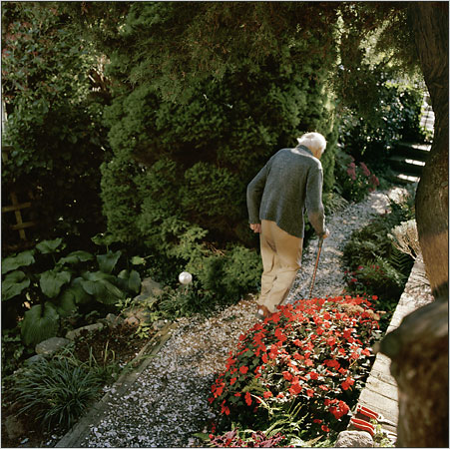
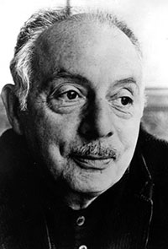
Former Poet Laureate Stanley Kunitz, when he was well into his nineties, said it was as hard to write a poem as it had always been. He had read and written and studies for a lifetime, but he still had to go through this mysterious process of “not knowing” each time he sat down to write.

Slide 30
So given then you don’t know where you are going, how do you take the first step?
The first step: STOP. This means to sit still for a moment. It doesn’t need to be a long moment—just enough to clear your head and center your body.
Experience your own awareness, without thoughts chasing the past or future

Slide 31
Get rid of the junk—Ad slogans and TV commercial jingles. Get rid of repetitive thoughts about fears and desires and writing projects and plans for the weekend.

Slide 32
So, let’s just try to freewrite.
And, to be more formal about it, everyone’s favorite questionable online source Wikipedia explains Free writing is a prewriting technique in which a person writes continuously for a set period of time without regard to spelling, grammar, or topic. It produces raw, often unusable material, but helps writers overcome blocks of apathy and self-criticism.

Slide 33
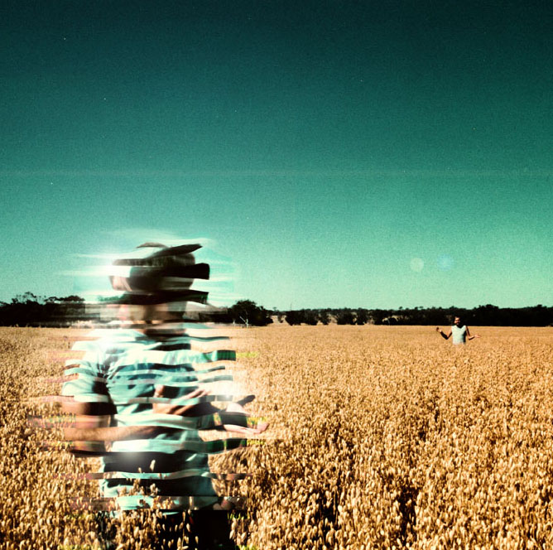
A Process for Recovering Memories
Recall a pleasant time in the past.
A building in which you once lived.
A secret you once had.
Magical person from childhood.
Recall an incident that filled you with dread.
Something dangerous you did when you were young.
Something “sinful” or bad you did as a child.
Something that happened during a school vacation.
Something that happened in a classroom or schoolyard.
Something that happened near a body of water.
Recall your first romantic infatuation.
Recall something funny that made you laugh.

Slide 34
First Poetry Assignment: Narrative
(Handouts)
Since a narrative is a story the idea of this poem is to, well, tell a story. Did something memorable or just slightly quirky happen to you or someone you know, something that leaves a question in your mind or an image you can’t get rid of? See how that story comes out in poetry.

Slide 35
Let’s look at some Poems
“Bike Ride with Older Boys”
Those Winter Sundays”
“Borges at the Northside Rotary”

Slide 36
Other Handouts
Poetic Terms
Optional Reading: “What Makes Good Poetry?” The Shape of Poetry

